Slide 1



Carbon Emission Prediction
NAME:- Vanapalli Madhu Kishore
AICTE Internship Student Registration ID : STU67716223e72d21735483939

Slide 2

Learning Objectives
Data Handling and Preprocessing:
Import and clean datasets using Pandas, focusing on removing outliers and handling missing values for better data quality.
2.Feature Selection:
Use Recursive Feature Elimination with Cross-Validation (RFECV) to identify key features that impact CO₂ emissions predictions.
3.Model Training and Evaluation:
Train Random Forest models and evaluate their performance with metrics like R² and RMSE, while optimizing through hyperparameter tuning.
4.Growth Rate Calculation:
Calculate Compound Annual Growth Rate (CAGR) to analyze trends and make future predictions
5.Forecasting:
Predict future CO₂ emissions per capita for selected countries using historical data and growth rates.
6.Data Visualization:
Create informative plots with Matplotlib and Seaborn to effectively communicate analysis results.
GOAL
Source :
www.freepik.com/

Slide 3
Tools and Technology used
Python: The primary programming language used for data analysis and machine learning tasks, providing a versatile environment for coding.
Pandas: A powerful library for data manipulation and analysis, allowing easy handling of datasets, including cleaning and preprocessing.
NumPy: A library for numerical computations that supports efficient array operations, essential for handling data in machine learning.
Scikit-learn: A machine learning library that provides tools for model training, evaluation, and feature selection, including Random Forest and RFECV.
Matplotlib: A plotting library used to create static, interactive, and animated visualizations in Python, helping to visualize data and results.
Seaborn: A data visualization library based on Matplotlib that provides a high-level interface for drawing attractive statistical graphics.
Google Colab: An online platform that allows coding in Python with access to powerful computing resources, making it easy to run and share Jupyter notebooks.

Slide 4
Methodology
Data Import and Cleaning:
started by importing the cleaned dataset and removing outliers to ensure the data was reliable for analysis.
Feature Selection:
identified the most relevant features for predicting CO₂ emissions using Recursive Feature Elimination with Cross-Validation (RFECV) to enhance model accuracy.
Model Training:
trained a Random Forest Regressor on the selected features, optimizing the model through hyperparameter tuning to improve performance.
Model Evaluation:
evaluated the model using cross-validation, calculating metrics like R², Mean Squared Error (MSE), and Root Mean Squared Error (RMSE) to assess its effectiveness.
Growth Rate Calculation:
calculated the Compound Annual Growth Rate (CAGR) for key features to understand trends over time and inform future predictions.
Forecasting:
Using the trained model, I forecasted CO₂ emissions per capita for selected countries over the next 20 years based on historical data and growth rates.
Data Visualization:
Finally, I visualized the results using Matplotlib and Seaborn to effectively communicate the findings and insights from the analysis.

Slide 5
Problem Statement:
The increasing levels of CO₂ emissions are a significant contributor to climate change, posing serious environmental and health risks worldwide. This project addresses the urgent need to analyze and predict CO₂ emissions per capita for various countries, as understanding these trends is essential for effective policy-making and environmental management. The primary challenge lies in developing a robust predictive model that accurately identifies the factors influencing CO₂ emissions. This involves exploring historical data on CO₂ emissions, economic indicators, and other relevant features to understand their relationships and impacts.
To achieve this, it is crucial to determine which variables are most significant in predicting emissions. Techniques like Recursive Feature Elimination with Cross-Validation (RFECV) will be employed to filter out less relevant features, ensuring that the model focuses on the most impactful data. Once the relevant features are identified, the next step is to train a machine learning model, specifically a Random Forest Regressor, to forecast future CO₂ emissions based on these selected features. The model's accuracy will be evaluated using metrics such as R², Mean Squared Error (MSE), and Root Mean Squared Error (RMSE) to ensure its reliability.
Ultimately, the goal is to predict CO₂ emissions per capita for selected countries over the next 20 years, providing valuable insights into future trends. This information can help stakeholders make informed decisions and formulate strategies to reduce carbon footprints and mitigate the impacts of climate change. By addressing these challenges, the project seeks to contribute to a broader understanding of CO₂ emissions and support efforts to combat climate change through data-driven insights and forecasts.

Slide 6
Solution:
To tackle the problem of predicting CO₂ emissions per capita, we implemented a comprehensive approach that combines data analysis, machine learning, and visualization techniques. First, we gathered and cleaned a dataset containing historical CO₂ emissions and relevant features, ensuring data quality by removing outliers and handling missing values.
Next, we employed Recursive Feature Elimination with Cross-Validation (RFECV) to identify the most significant variables influencing CO₂ emissions. This step allowed us to focus on the key factors that would enhance the accuracy of our predictive model.
We then trained a Random Forest Regressor, a powerful machine learning algorithm, using the selected features. To optimize the model's performance, we conducted hyperparameter tuning and evaluated its effectiveness using metrics such as R², Mean Squared Error (MSE), and Root Mean Squared Error (RMSE).
Once the model was trained and validated, we used it to forecast CO₂ emissions per capita for selected countries over the next 20 years. This forecasting process involved calculating the Compound Annual Growth Rate (CAGR) for various features, which helped us understand trends and make informed predictions.
Finally, we visualized the results using Matplotlib and Seaborn, creating informative plots that effectively communicated our findings. This solution not only provides insights into future CO₂ emissions but also supports policymakers and researchers in their efforts to address climate change and develop strategies for reducing carbon emissions.

Slide 7
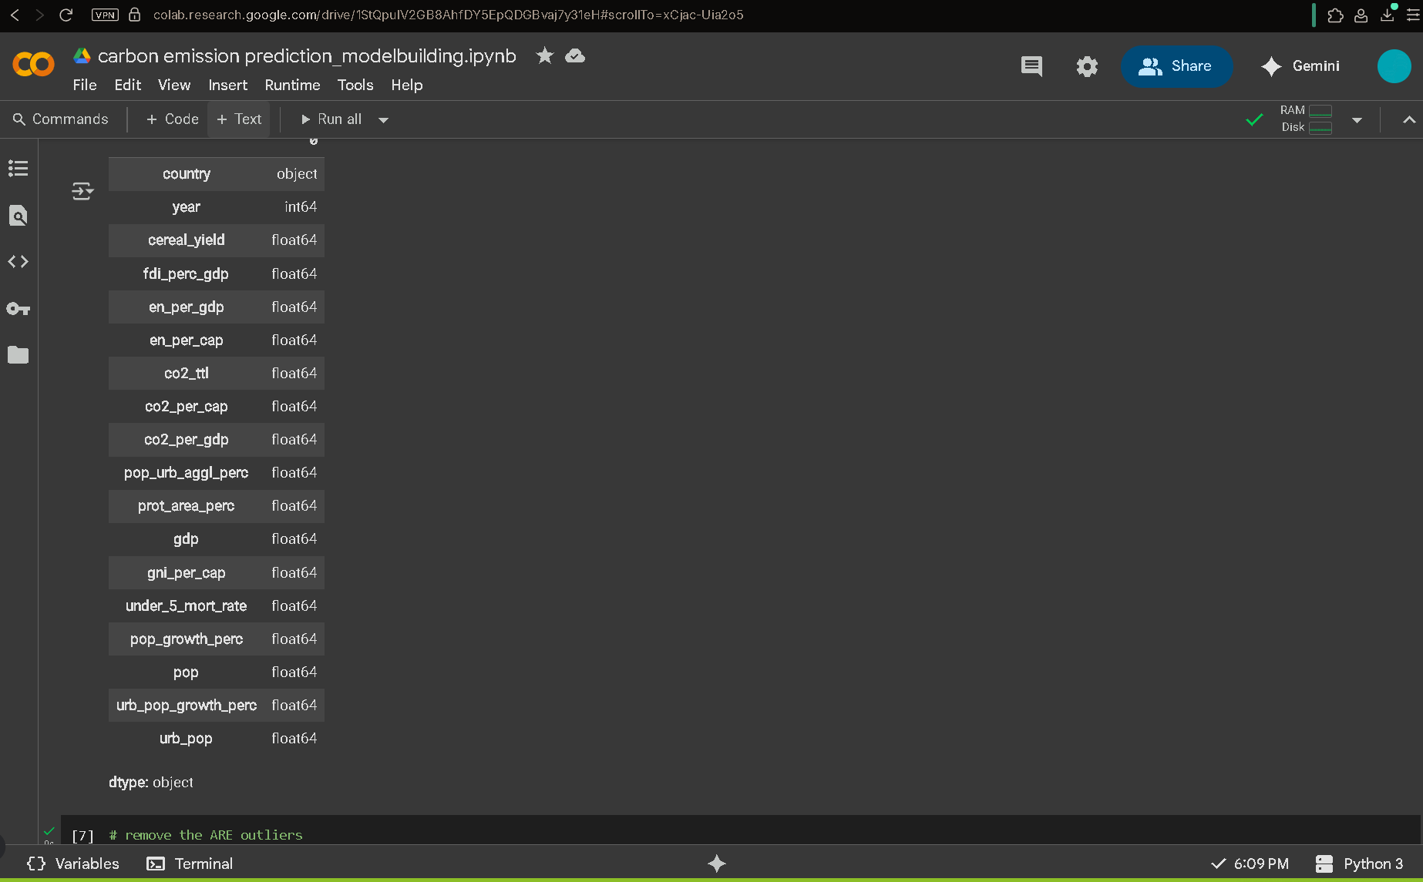
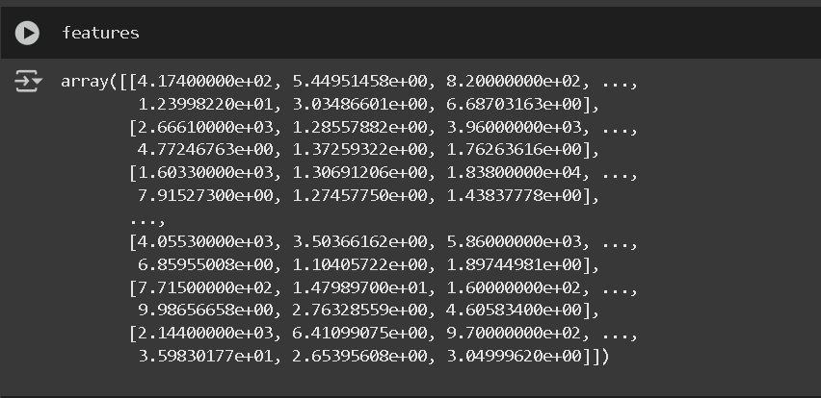
Screenshot of Output:

Slide 8
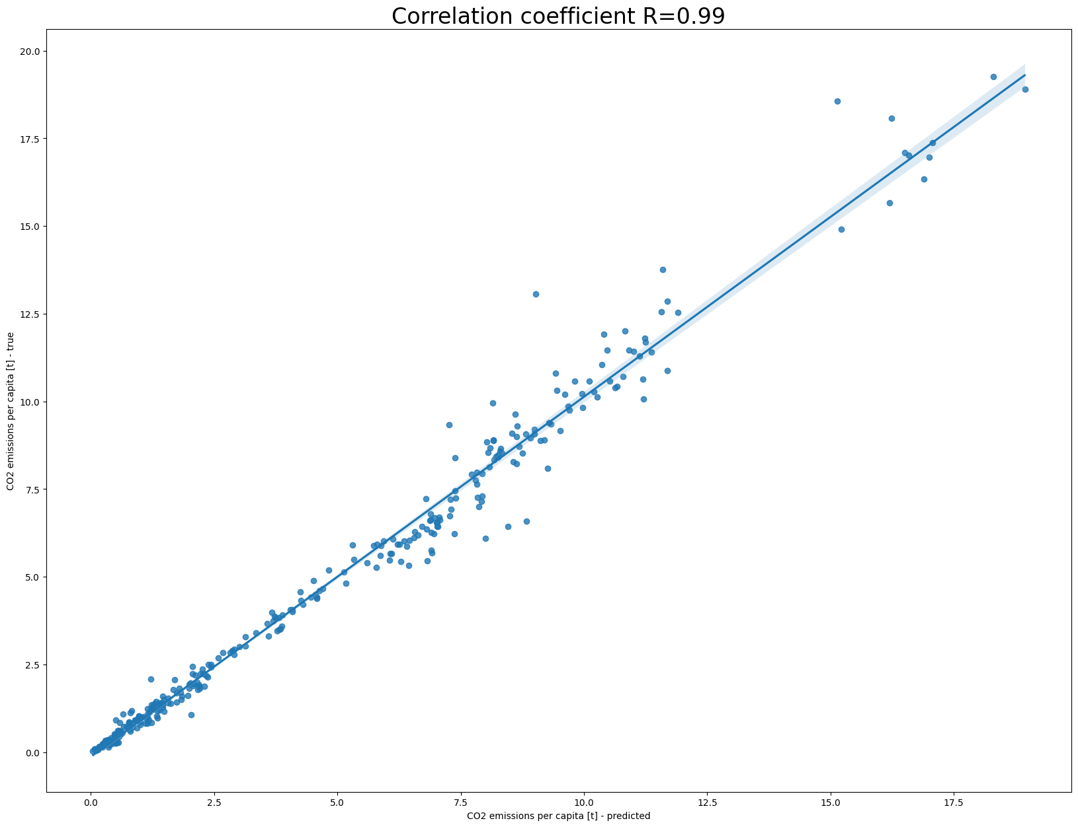
Screenshot of Output:

Slide 9
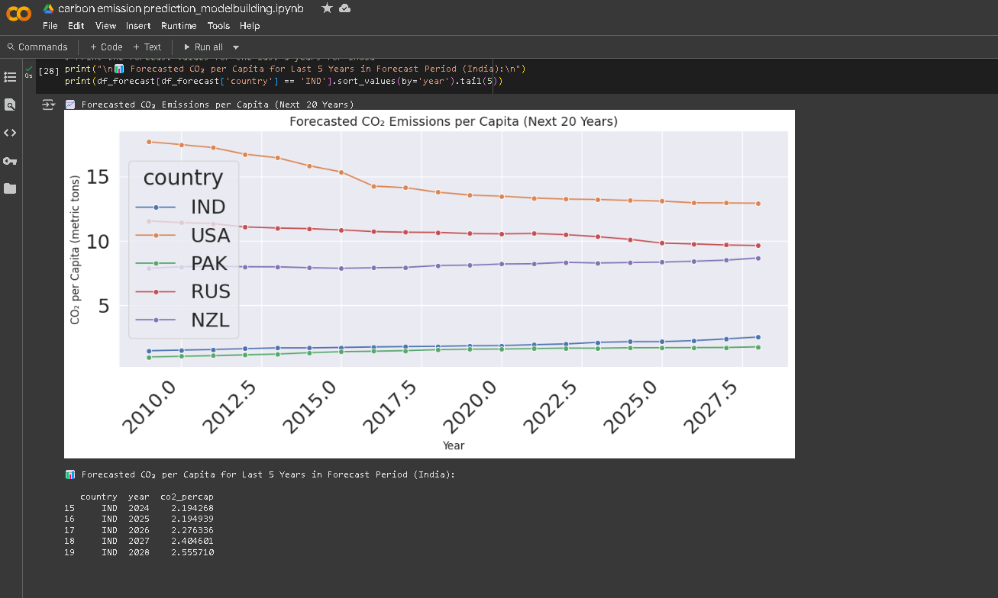
Screenshot of Output:

Slide 10
Conclusion:
In conclusion, this project successfully addressed the challenge of predicting CO₂ emissions per capita for various countries by employing a systematic approach that combined data analysis, machine learning, and visualization. Through careful data cleaning and preprocessing, we ensured the reliability of our dataset, which was crucial for accurate predictions. By utilizing Recursive Feature Elimination with Cross-Validation (RFECV), we identified the most significant features impacting CO₂ emissions, allowing us to build a focused and effective predictive model.
The Random Forest Regressor we trained demonstrated strong performance, as evidenced by the evaluation metrics such as R², Mean Squared Error (MSE), and Root Mean Squared Error (RMSE). Our forecasts of CO₂ emissions over the next 20 years provide valuable insights into future trends, which can inform policymakers and stakeholders in their efforts to combat climate change.
The visualizations created throughout the project effectively communicated our findings, making complex data more accessible and understandable. Overall, this project not only highlights the importance of data-driven approaches in environmental analysis but also contributes to the ongoing dialogue on sustainability and climate action. By providing a clearer understanding of CO₂ emissions trends, we hope to support initiatives aimed at reducing carbon footprints and promoting a healthier planet for future generations.

